Slide 1
Android Team: Abhay Gupta Gaurav Halbe Mayank Chacko Rohit Kandhal
Walk North Hills

Slide 2
Presentation Outline
Quick Recap
New Approach
Prototype
Things Remaining
Q&A

Slide 3
About the ‘Walk Campaign’
Initiated by Matt Tomasulo
Encourage people to walk
Integrates key features of initial physical campaign

Slide 4
New Approach
Keep the app simple ( No weather, refresh etc. )
Dynamic Database
Google Maps API integration
Showing walkable route between two places
Category Selection

Slide 5
Things left to do…
Creating of local copy of database
Addition of info view about the destination
Bonus…
Favorites option…
Achievements section..
Integration of list and map view with the main app

Slide 6
Google Distance Matrix api
Source
Destination 1
Destination 2
Destination 3
Destination 4
Destination 5
 | Destination 1 | Destination 2 | Destination 3 | Destination 4 | Destination 5
Source | 3 km/ 15 mins | 6 km/ 30 mins | 9 km/45 mins | 10km/50 mins | 1 km/ 5 mins

Slide 7
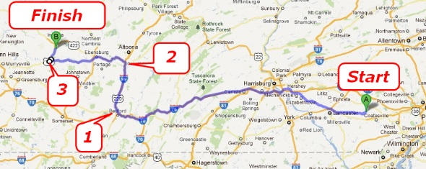
Google Direction Api

Slide 8
Prototype

Slide 9
Questions?

